Slide 1

David Hoff
Maria Paiewonsky
Institute for Community Inclusion
University of Massachusetts, Boston www.communityinclusion.org
Universal Design

Slide 2

Discussion
How familiar are you with the term and concepts of universal design?

Slide 3


Slide 4

Universal Design
Create environments that are usable by as many people as possible regardless of their age, size, ability, or disability

Slide 5
Incorporating Universal Design
Design environment to meet needs of all people who wish to use it
Flexibility in use – not
“one size fits all”
Meeting needs of people with disabilities is no longer considered “Special” or “Extra”
Universal Design is Good Design

Slide 6



Different Paths – Same Destination

Slide 7

Design and composition of environment so that it may be accessed, understood and used:
  To greatest possible extent
  In most independent and natural manner possible
  In widest possible range of situations
  Without need for adaptation, modification, assistive devices or specialized solutions, by any persons of any age or size or having any particular physical, sensory, mental health or intellectual ability or disability

Slide 8





Slide 9
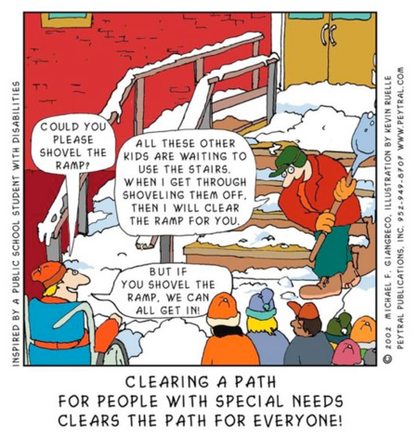

Slide 10


Slide 11
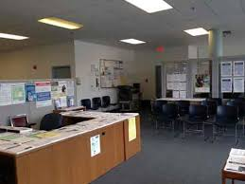

Universal Design Applies To:
Physical environment
Learning environment
Service environment

Slide 12
Universal Design
Universal Design for Learning

Slide 13
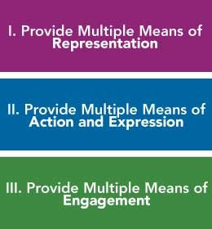
Principles of Universal Design for Learning

Slide 14

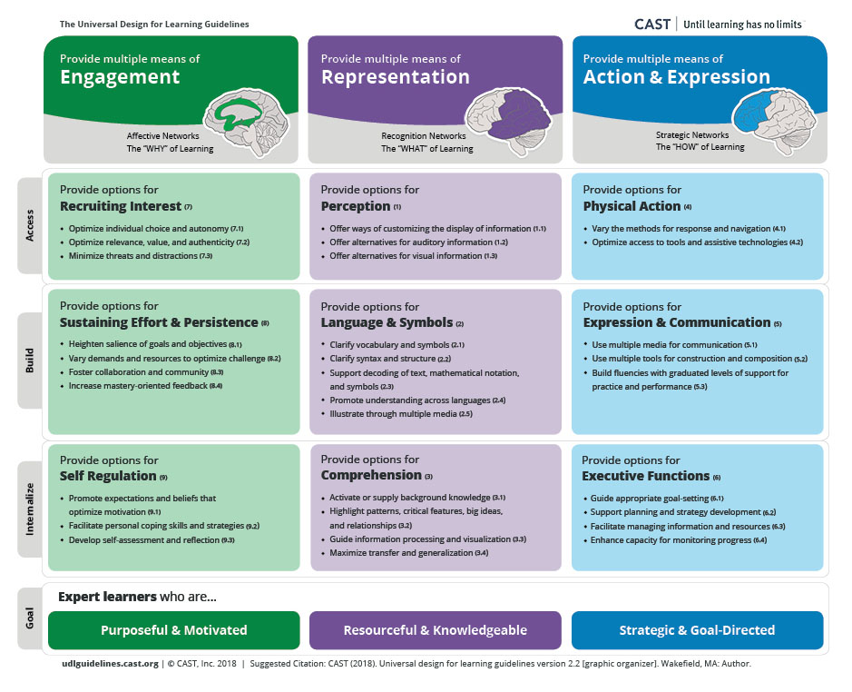
UDL Guidelines

Slide 15

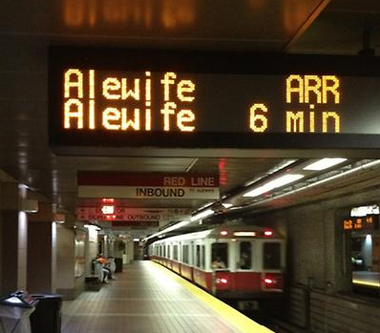


Slide 16



Slide 17
Public Policies that Support a Person with a Disability Working with a Job Coach
The Rehabilitation Act of 1973 authorizes public VR funding for the individual’s job development and placement activities
CMS Waiver Program provides Medicaid funding for long-term placement supports such as job coaching and other assistance
The Americans with Disabilities Act provides the right to reasonable accommodation, rights to to non-discrimination in hiring, and requires provision of accessible public transportation
The Ticket to Work and Work Incentives Improvement Act of 1999 allows the individual to maintain health insurance through the state’s Medicaid buy-in program, and establishes benefit counseling through the Work Incentive Planning & Assistance Program to help individual manage benefits

Slide 18
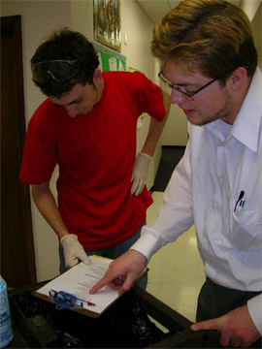

Slide 19
Rehabilitation Act
Authorizes public VR
funding for job development & placement
CMS Waiver Program
Medicaid funding for
long-term placement supports
1) Right to accommodation
2) Non-discrimination in hiring
3) Accessible transportation
Americans with Disabilities Act
Ticket to Work & Work Incentives Improvement Act
1) Maintain health insurance through Medicaid buy-In
2) Benefits counseling

Slide 20

Does universal design mean that individual accommodations are no longer necessary?

Slide 21
Jacqueline McGinty
Tips for Creating Inclusive and Accessible Instruction for
Adult Learners
Individuals with disabilities often self-accommodate due to issues regarding lack of trust and concern for negative consequence of disclosing their disability.
The practice of nondisclosure and self-accommodation does not always offer the full spectrum of accessibility options that may be available to the student.
There is considerable effort required in disclosing one’s disability and it is viewed as a barrier to full participation because of the effort it takes to report and request assistance within the institution.
Creating a disability-friendly institutional climate is one way to improve outcomes for learners with disabilities.

Slide 22
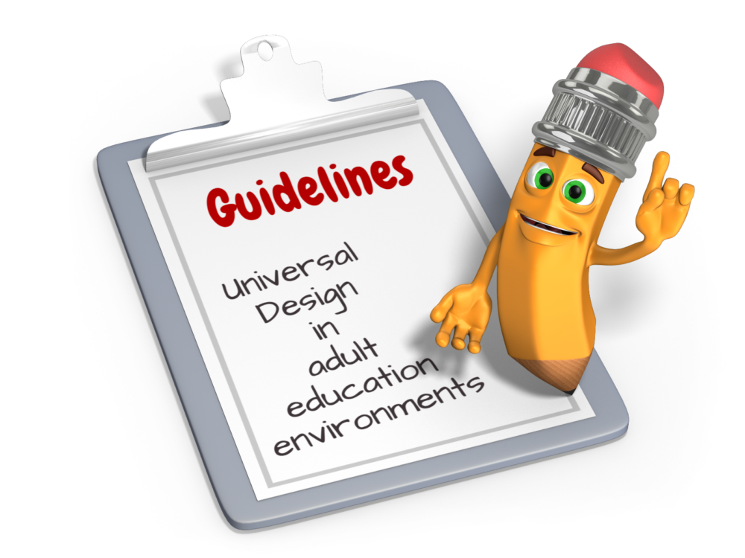
Anticipate needs
Information available in multiple formats
Stress goal of universal access to students
Avoid presumptions
All students asked about support and accommodation needs
Disability-specific information to all students
Provide a list of possible accommodations
Maintain and respect confidentiality
Incorporate feedback on universal access in evaluation
In-person and online
Process never ends

Slide 23





Brainstorming on UD Strategies
Environment
Curriculum
Instruction
Assessment

Slide 24

Don’t Forget About UD Digitally and Online
Examples
Closed caption video
Images with alternate text
Compatibility with screen reader
Easy navigation

Slide 25
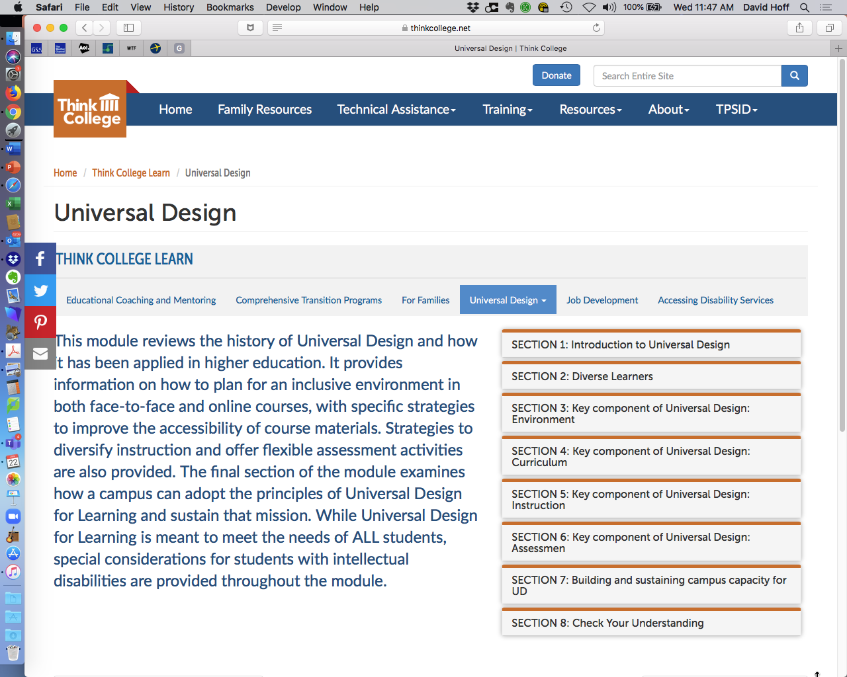


Slide 26
POLICIES
PRACTICES
PROCEDURES
Universal Design

Slide 27
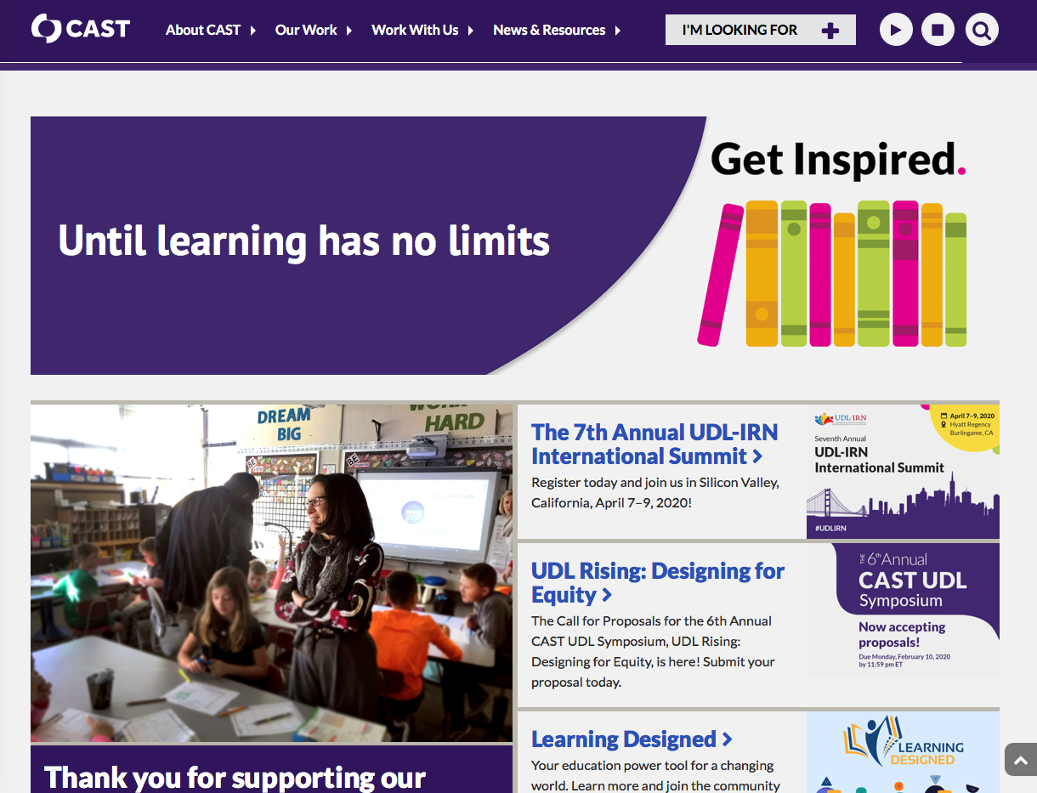
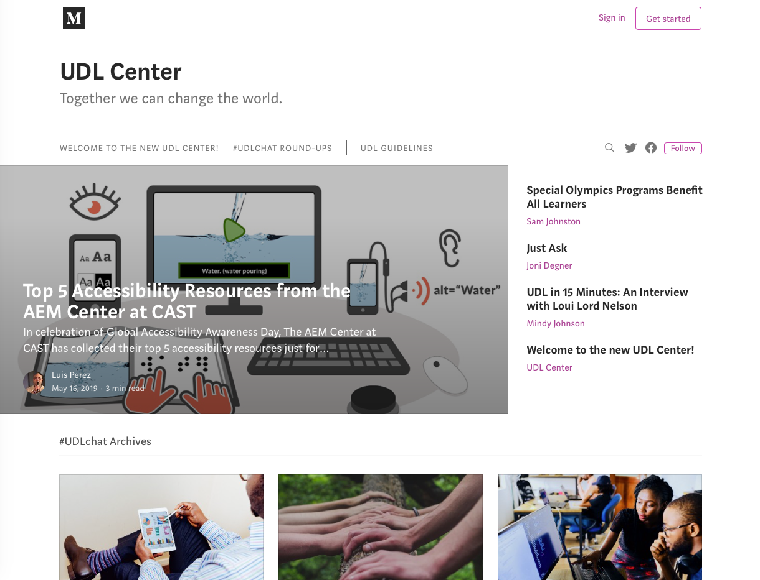
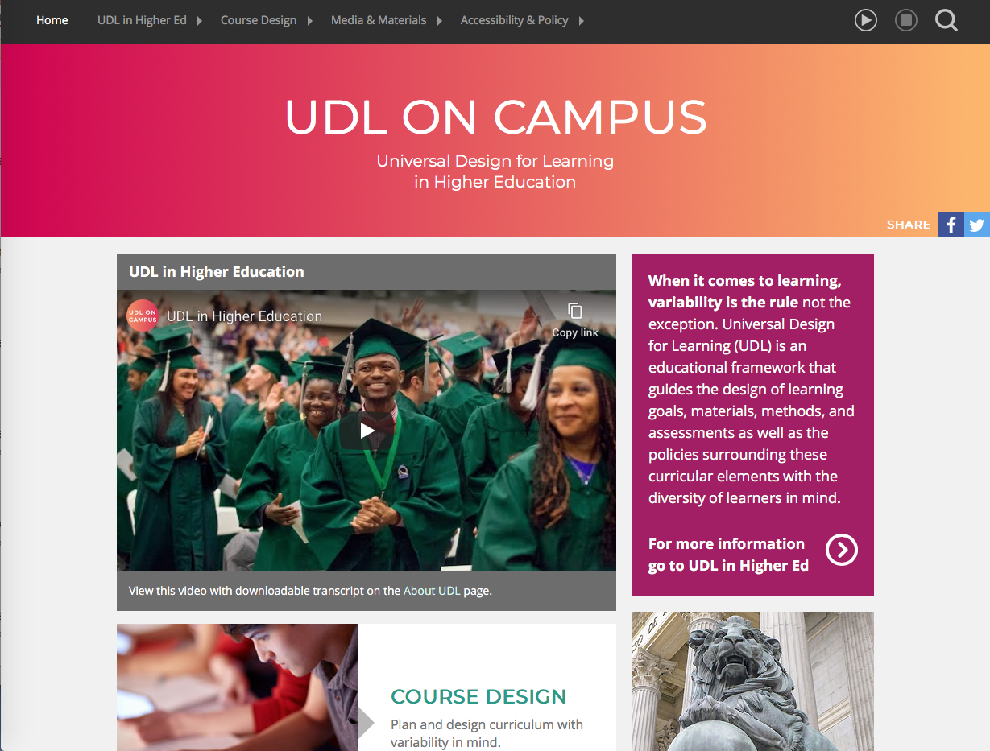
UDL
Resources

Slide 28
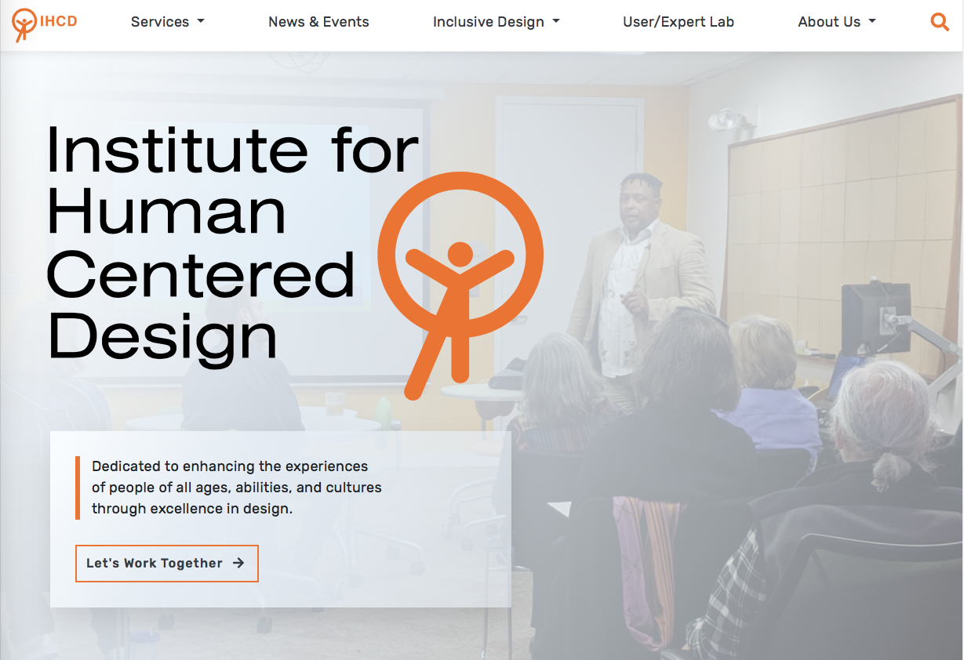

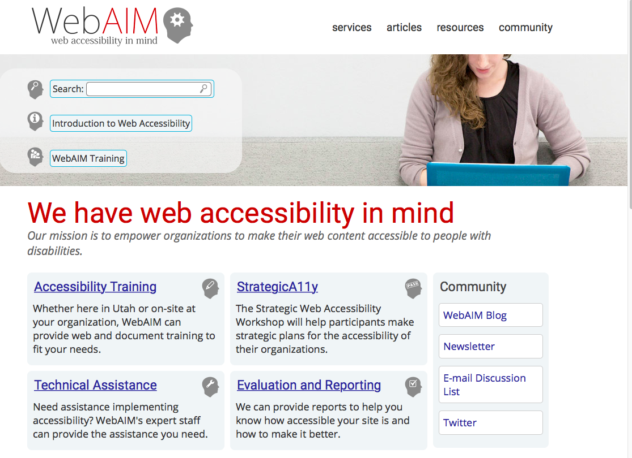
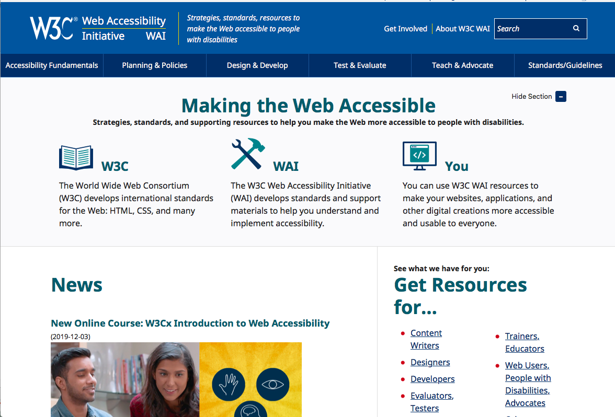
Additional UD Resources

Slide 29
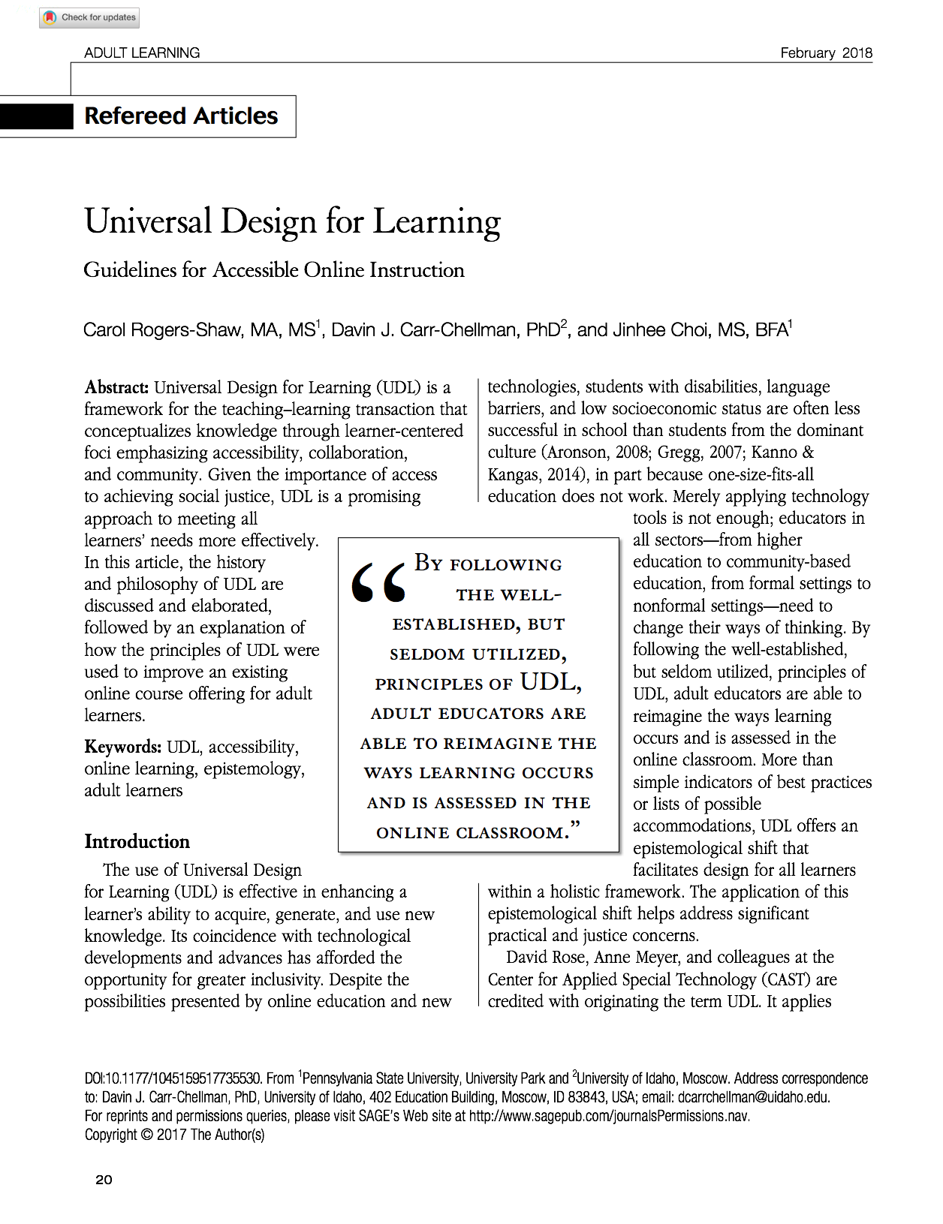
Handouts
PowerPoint
UD Resources
Article: Tips for Creating Inclusive and Accessible Instruction for Adult Learners
Article: Universal Design for Learning – Guideline for Accessible Online Instruction

Slide 30


Questions, Comments

Slide 31

“Attitudes are caught, not taught.”
Fred Rogers

Slide 32




